Slide 1

Mining and Refining Digital Gold
Nevada Office of Attorney General
LE

Slide 2

Mining and Refining Digital Gold
A Practical Guide to Digital and Electronic Evidence for Nevada Prosecutors
LE

Slide 3
Objectives
As a result of this training, you will be able to:
1. Understand how crimes leave digital clues
2. Identify likely sources of digital evidence
3. Preserve volatile digital and electronic evidence
4. Obtain digital and electronic evidence
5. Get that evidence in front of your judge/jury
LE

Slide 4
Hawk Analytics – CellHawk

Slide 5

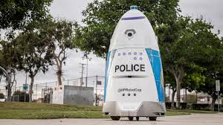
The Digital “Crime Scene”
Yesterday
Today
LE

Slide 6


Your “Crime Scene” is Bigger Than You Think
Physical Crime Scene
Digital Crime Scene

Slide 7
How Your Crime May Involve Tech
Tech Use in Crime
Digital Footprints
Target or Means (Hacking, Sim Swap, Account Takeover, Online Threats….)
Planning and Preparation (Maps, Research, Messages….)
Coordination (GPS, Messaging Apps, Surveillance)
Facilitation/Execution
Post Crime (Bragging, Intimidation….)
IP Logs (Wifi too)
Cell Tower Connections
Social Media Activity
IOT
Subscriptions/Apps
Purchases
Location
Metadata

Slide 8

Tech is Always Watching
Surveillance and Traffic Cameras
License Plate Scanners
Cell Tower “pings”
Wifi and RFID scanning
Cookies
Webcams
Bluetooth beacons
“Smart” Devices
Car Computers
Email Scanning
Loyalty Programs
Ride Share Apps
Exif Data

Slide 9
Problems Posed By Tech
ANONIMITY
JURISDICTION
Screen Names/Handles
Open Wifi
VPNs
Tor and Onion Routers
Spoofing and Obfuscation
Crossing County, State or Even Country Borders
Multiple Victims in Different Jurisdictions
Process “Immune” Providers

Slide 10
National Computer Forensics Institute

Slide 11
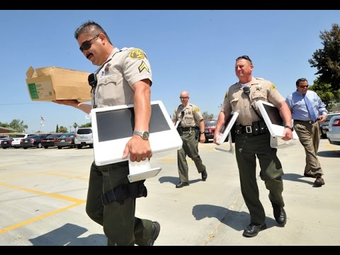
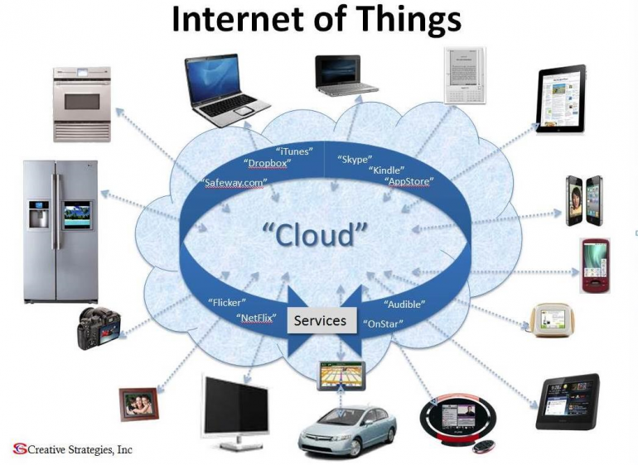
sources of digital evidence
Not as Easy as it Used to Be.
LE

Slide 12
Who/Where ?
Open Source (OSINT)
Social Media
Government Sites
Databases
Academic Materials
Victims
Suspects
3rd Party Providers
Internet Service Providers
Apps and Websites
Telecommunication Providers
Financial Services

Slide 13
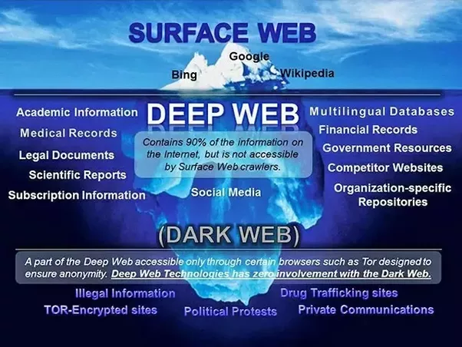
There’s More Out There Than You Know

Slide 14
OSINT Techniques (osintechniques.com)

Slide 15
Special Considerations
Victims
Consent to search
Physical Devices
Apps/Accounts
Account Takeovers
Privacy Issues (Discovery)
Suspects
Consent – Doesn’t Hurt to Ask, BUT – Revocation Issues
3rd Party Consent, Is it valid?
Seizure v. Search
Piggyback Warrant
Timing

Slide 16
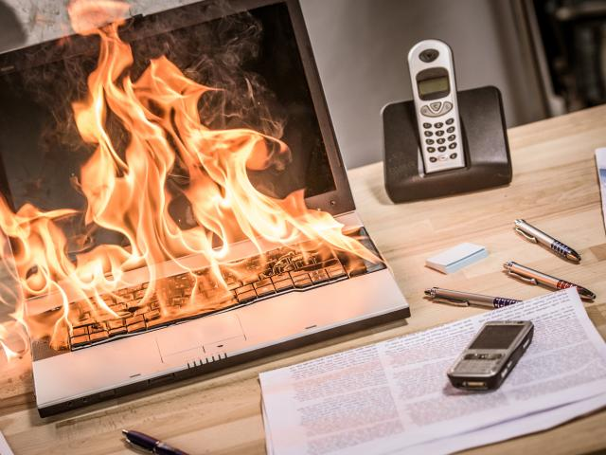
Preserving Volatile Evidence
LE

Slide 17
National White Collar Crime Center

Slide 18

Physical Preservation

Slide 19
Usually, a Field Level Decision
Running Devices
There are rules/guidlines
There are protocols for the collecting volatile evidence. Volatile evidence should be collected based on the order of volatility; that is, the most volatile evidence should be collected first, and the least volatile should be collected last. The Request for Comments (RFC) 3227 document provides the following sample of the order of volatile data (from most to least volatile) for standard systems (Brezinski and Killalea, 2002):
There are protocols for the collecting volatile evidence. Volatile evidence should be collected based on the order of volatility; that is, the most volatile evidence should be collected first, and the least volatile should be collected last. The Request for Comments (RFC) 3227 document provides the following sample of the order of volatile data (from most to least volatile) for standard systems (Brezinski and Killalea, 2002):
registers, cache
routing table, ...[address resolution protocol or ARP] cache, process table, kernel statistics, memory
temporary file systems
disk
remote logging and monitoring data that is relevant to the system in question
physical configuration, network topology
archival media
For more information see: Brezinski, D. and T. Killalea. (2002). Guidelines for Evidence Collection and Archiving . Request for Comments: 3227.

Slide 20
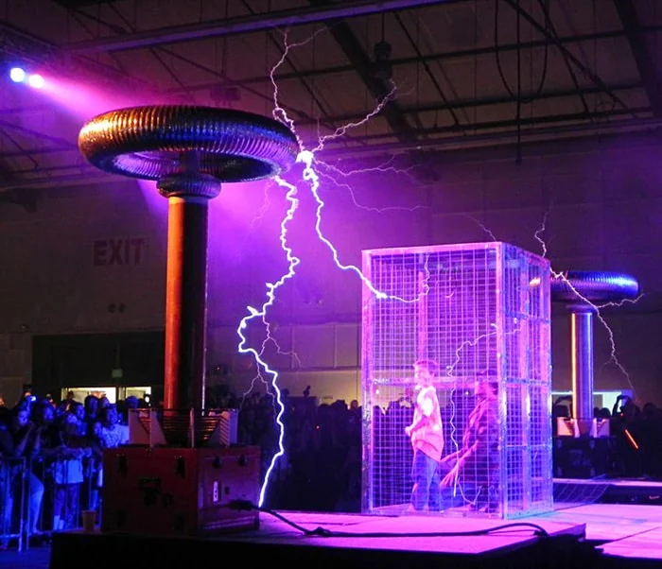
Considerations
Remote Access
Faraday bags, cages, write blockers (hardware/software)
Isolate from Network
Be Aware of Cellular, Wi-Fi, Bluetooth
Seize unique peripherals/connectors
Batteries?

Slide 21

Preserving 3rd Party Data
Preservation Letters
Locating Contacts for Service
Language

Slide 22
Preservation Letter
18 U.S. Code §2703(f)
"A provider of wire or electronic communication service or a remote computing service, upon the request of a governmental entity, shall take all necessary steps to preserve records and other evidence in its possession pending the issuance of a court order or other process.“
Essential Elements
Identify the Account
Request Preservation of
Subscriber data
Transactional data
Content
Data is preserved for 90 days from receipt
May be extended on request for another 90 days
Account Registration (ID)
Email, Chats, Messages, Media, Posts, IP Logs, GPS & Location, $$$

Slide 23
Sources of Contacts/Guides/Templates
National White Collar Crime Center (NW3C.org)
Search.org
Hawk Analytics – (www.hawkanalytics.com)
Provider Portals
Facebook https://www.facebook.com/records/login/
Uber Public Safety Response Portal (https://lert.uber.com/s/?language=en_US)
Etc…..

Slide 24

Warning – Disclosure Policies
Check LE Guides for Disclosure Policy
A sealing/delayed notice order may be required (18 USC 2705) (90 and 90)
Keep and eye on the clock

Slide 25
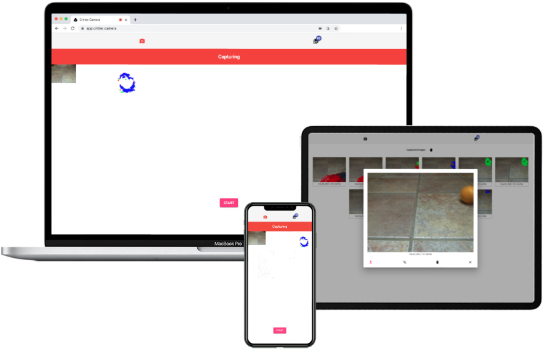
Cool and Unusual
critter.camera
Hmmm, what could this be used for?????
Ever wondered what was running around your floor at night...well now you can find out!
Critter.Camera lets you turn any phone, tablet or laptop into a motion activated camera
Private and secure - no data is sent over the internet and all images are stored locally on your browser
Highly sensitive motion detection will capture everything from human beings to tiny insects
Simply place the device pointing at the area to watch, press start and leave it to do its thing
When you return any motion detected will have been saved as downloadable images ready for you to review

Slide 26
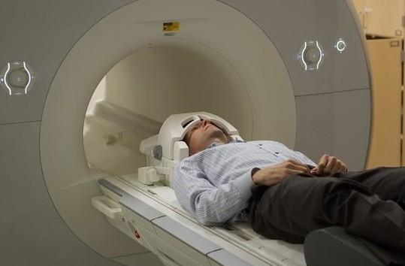
Obtaining digital and electronic evidence
LE

Slide 27
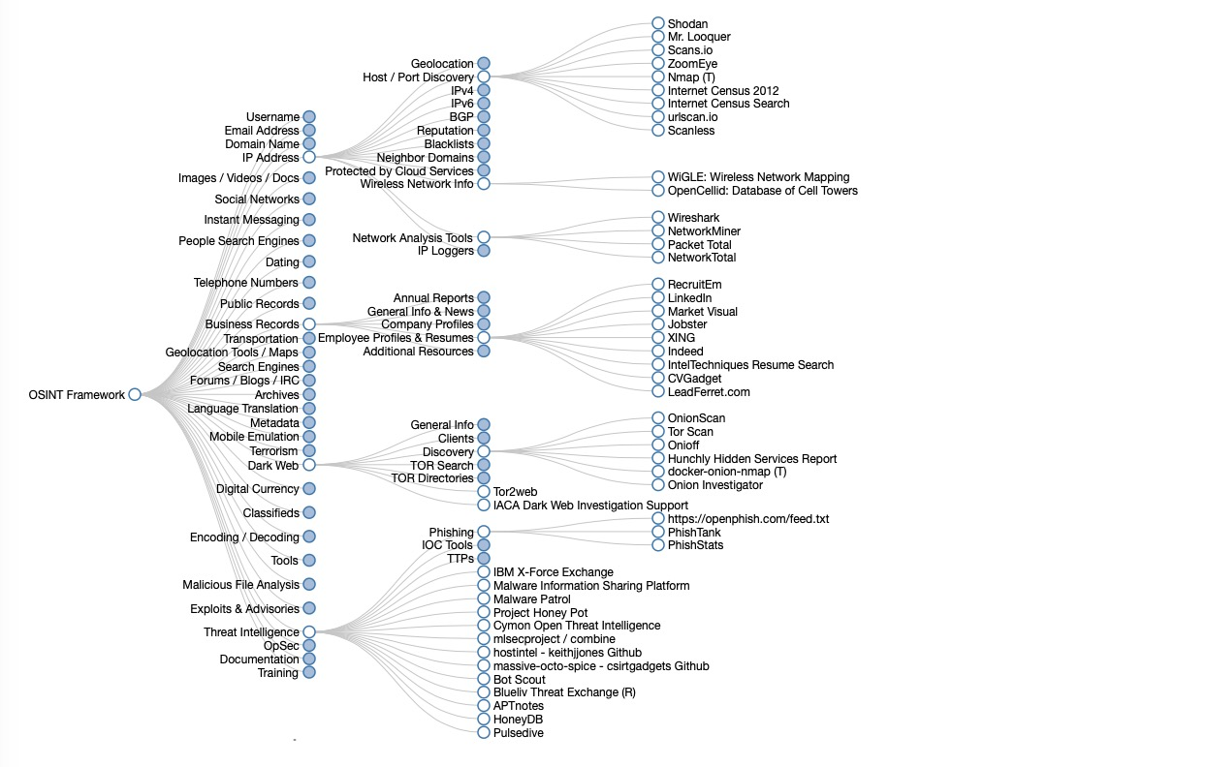
Where? Easy to Get
Open Source
Social Media Apps
Victims/Witnesses
Photos/Videos
Cal Logs
Texts/Messages
Posts/Replies

Slide 28
Where – Harder to Get
Suspect
Probation/Parole Search
Consent
Inventory Search
Search Incident to Arrest
Shared (See Open Source)
Search Warrant
3rd Parties
Shared (See Open Source)
Voluntary Disclosure
2703(d) Order (very limited)
Subpoena (limited)
Search Warrant **

Slide 29
You’ve Got It, How To Understand It
Certification
Account Registration
Identifiers (Name, Email, Phone #, IP)
Content (Format?)
.Social – Text editors, converters (authentication?)
"favorite_count" : "0", "in_reply_to_status_id_str" : "1384913891684241410", "id_str" : "1401328092174426116", "in_reply_to_user_id" : "1084576516472782850", "truncated" : false, "retweet_count" : "0", "id" : "1401328092174426116", "in_reply_to_status_id" : "1384913891684241410", "possibly_sensitive" : false, "created_at" : "Sun Jun 06 00:00:27 +0000 2021", "favorited" : false, "full_text" : "@cannastarz https://t.co/m7MS2FmP0f", "lang" : "und", "in_reply_to_screen_name" : "cannastarz", "in_reply_to_user_id_str" : "1084576516472782850", "extended_entities" : { "media" : [

Slide 30
Resources – The Internet Archive

Slide 31
Internet Archive and Google Earth….
printouts from the “Internet Archive” reflecting third-party use of the mark. Most, if not all, of the printouts were accompanied by affidavits from the “Internet Archive” office manager providing relevant information about the database, and as such, they were properly authenticated.
Memory Lane, Inc. v. Classmates, Inc., 646 Fed. Appx. 502, 504 (9th Cir. 2016)
labeled GPS coordinates—there's no statement as defined by the hearsay rule. In reaching that conclusion, we join other circuits that have held that machine statements aren't hearsay.
See United States v. Lamons, 532 F.3d 1251, 1263 (11th Cir.2008); United States v. Moon, 512 F.3d 359, 362 (7th Cir.2008); United States v. Washington, 498 F.3d 225, 230 (4th Cir.2007); United States v. Hamilton, 413 F.3d 1138, 1142 (10th Cir.2005); United States v. Khorozian, 333 F.3d 498, 506 (3d Cir.2003).
United States v. Lizarraga-Tirado, 789 F.3d 1107, 1110 (9th Cir. 2015)

Slide 32

ADMITTING DIGITAL EVIDENCE
LE

Slide 33
It’s Really No Different
Theory of Admissibility
Preparing your evidence and witnesses
Laying a foundation (both for your evidence and with the court)
Anticipating and Meeting Objections
Special consideration and strategies

Slide 34
Theories of Admissibility
Why do you want the evidence?
48.015. “Relevant evidence” defined
As used in this chapter, “relevant evidence” means evidence having any tendency to make the existence of any fact that is of consequence to the determination of the action more or less probable than it would be without the evidence.

Slide 35
Theories of Admissibility (Relevance)
Direct Evidence
Operative Fact
Identity
Intent
Knowledge
Motive
Lack of Mistake
Basis of Expert Opinion
Eliminates a Defense
Corroboration
Credibility (impeachment)
Circumstantial Evidence

Slide 36
Preparing Evidence and Witnesses
Prepare Exhibits (Organization is Key)
Walk Witness Through (No Surprises)
Understand Witness’s Limits
Consider an Offer of Proof
Ask Objections be Deemed Continuing
Think Through Witness Order Carefully

Slide 37
Laying a Foundation
Preparing the Court – Consider briefing
Judicial Notice
Authentication - Standard
Weight vs. Admissibility
Anticipate Common Objections (Educate)
Expect bad rulings (belts and suspenders time)

Slide 38
Foundation - Authentication
Evidence is what it purports to be
Truth of Content Irrelevant
Multiple Approaches
Links to Device
Links to Accounts
Security Measures (passwords, pin, biometrics)
Official Publication/Newspapers/Periodicals (NRS 52.135, NRS 52.145)
Business Record (declaration of custodian) (NRS 52.260)
Preparer or witness to preparation (NRS 52.025)
Location
Content
Comparison to known evidence
Reliance
Metadata (NRS 52.105)
Process (NRS 52.105)
Public Records/Reports (NRS 52.085)

Slide 39
Validating Software/Tools
NIST – National Institute of Standards and Training (Computer Forensics Tool Testing Reports)
SWGDE – Scientific Working Group on Digital
American Society of Crime Lab Directors (ASCLD)

Slide 40
Objections
Hearsay
Best Evidence Rule
Alteration or Enhancement
Confrontation Clause
Prejudice

Slide 41
Objection - Hearsay
Are You Offering it For the TRUTH?
Operative Facts (Threats/Orders/Instructions)
Party Statement (NRS 51.035)
Adoptive Admission (NRS 51.035)
Computer Generated Records Are NOT Hearsay
IP logs, Google Earth GPS Points, Email headers, Metadata, date/time stamps
Exceptions
Admissions/Party Statements
Business Records (NRS 51.135)
Government Records (NRS 51.155)
Present Sense Impression (NRS 51.085)
Excited “Utterances” (NRS 51.095)
Mental, Emotional, or Physical Condition (NRS 51.105)

Slide 42
Objections – Best Evidence Rule
F
NRS 52.195 – Duplicate Original
Photography, optical imaging, electronic rerecording; or
“other equivalent technique to ensure an accurate reproduction of original”
Federal Rules of Evidence 1101(3)
“[i]f data are stored in a computer or similar device, any printout or other output readable by sight, shown to reflect the data accurately, is an ‘original’.”

Slide 43
Special Consideration and Strategies
Delay in Obtaining S/W
Biometric Issues (Compelling unlocking/5th & 4^{th?})
Notification of Subscriber (sealing)
Account Takeover (Victim Consent)
Add S/W/ requirement to maintain copy of records in anticipation of subpoena (w/NRS 52.260 Certificate)
Use Charts, Diagrams, and Summaries (NRS 52.275)

Slide 44
Key Training Points
Be Aware How Digital Evidence May Play Into a Crime
Don’t Forget Old School Still Works
Recognize Sources of Potential Evidence
Secure and Legally Acquire Your Evidence
Lay a Foundation Through Education
LE

Slide 45
Key Reader

Slide 46
RESOURCE GUIDE
Government Organizations/Sites
Non-Government Organizations/Sites
Helpful Commercial Outfits/Sites
Reference Materials
LE

Slide 47
Thank you!
Contact Info: Jim Sibley, jsibley@ag.nv.gov
cell (831) 247-9888

